Slide 1
Software Project Management
By
Dr. Junaid Akram

Slide 2
Projects
Projects may involve a single person or thousands
Projects may be completed in hours, several months or years
Examples of projects
Developing a new product or service
Designing a new vehicle
Constructing a building
Developing a Software
Running a campaign for political office
Implementing a new business procedure or process
And so on …

Slide 3
What is Project Management ?
It is the discipline of
planning, organizing, and managing resources
to bring about the successful completion of
specific project goals and objectives
“Project management is the application of knowledge, skills, tools, and techniques to project activities in order to meet or exceed stakeholder needs and expectations.”

Slide 4
Project Management
Following are related to Project Management
Professional Organizations
Project Management Institute (PMI) (pmi.org)
Software Engineering Institute (SEI)
IEEE Software Engineering Group
Certifications
PMI’s PMP (Project Management Professional)
Tools
MS Project
Primavera Project Manager

Slide 5
Project Management
Project Management Skills
Leadership
Communications
Problem Solving
Negotiating
Influencing the Organization
Mentoring
Process and technical expertise

Slide 6
Project Management
Project Manager Positions
Project Administrator / Coordinator
Assistant Project Manager
Project Manager / Program Manager
Executive Program Manager

Slide 7
Project Management Knowledge Areas
PMI has suggested 9 Knowledge Areas
Project Integration Management
Project Scope Management
Project Time Management
Project Cost Management
Project Quality Management
Project Human Resource Management
Project Communications Management
Project Risk Management
Project Procurement Management

Slide 8
Software Project Management
A sub-discipline of project management in which software projects are planned, monitored and controlled

Slide 9
Project Planning
Its purpose is to identify the
scope of the project,
estimate the work involved,
and create a project schedule.
Project planning begins with requirements that define the software to be developed.
The project plan is then developed to describe the tasks that will lead to completion

Slide 10
Project Monitoring and Control
The purpose
To keep the team and management up to date on the project's progress.
If the project deviates from the plan, then the project manager can take action to correct the problem.
Project monitoring and control involves status meetings to gather status from the team. When changes need to be made, change control is used to keep the products up to date.

Slide 11

Project Manager
“The person who is responsible for the project and will be held accountable for its success or failure.”
Define and manage customer expectations.
Coordinate development of the project plan.
Monitor and control project work according to the approved plan.
Communicate project status by preparing status reports and conducting progress review meetings.
Establish and follow a change management process.
Lead the project team and resolve conflicts between team members.
Maintain the project notebook.
Conducting project close activities.
Notes:
Instructor Do
Read through the slide.
Indicate that the role of the project manager has been defined by PMI in the Code of Ethics for the project management professional, which will be discussed in a later section of the course.

Slide 12
The Triple Constraint
Project Scope
Cost
Quality
Within Available Resources
Schedule

Slide 13
How do products happen?
Products
Products
Tools
Technology
Methods
Products
Tools
Technology
Methods
Ideas

Slide 14
Which One to Select
VoIP
Oracle
Copernic
Internet
Intranet
Extranet
Object-Oriented
Java
UML
XML
Products
Tools
Technology
Methods
Software Engineering Project Management

Slide 15
Tools
Requirements Tools
Design Tools
Construction Tools
Test Tools
Maintenance Tools
CM Tools

Slide 16
Programming Languages
Your projects: do you choose a language?
Typically not the PM’s choice, but does effect you
Staffing requirements
Methodology
Tools and infrastructure

Slide 17
Project Management Process
Initiation
Planning
Execution
Controls
Closeout
To help guide you through the process you need a roadmap of some type …

Slide 18
Notes:
Instructor Say
Our second stop on the roadmap is the statement of work.
The statement of work is the first key planning document prepared.

Slide 19
Project Plan Contents
Statement of work (SOW)
Work breakdown structures (WBS)
Responsibility assignment matrices
Project schedule
Resource plans/histograms
Budget
Risk management plan
Communications plan
Quality plan
Verification and validation plan
Notes:
3
Instructor Say
The project plan consists of all of the information and documents prepared in the planning phase.
Instructor Do
Read through the slide.
Instructor Say
It also represents the first major section of the project notebook.

Slide 20
Project Plan Benefits
Provides an effective communication tool to ensure understanding of project goals and the means to achieve them
Defines outcomes and commitments
Establishes guidelines and standards
Establishes the baseline for evaluating and reporting progress
Forms the basis for scope control and change management
Notes:
Instructor Say
Read through the slide.
Has anyone ever picked up a project in the middle when the former project manager has been reassigned? What was that like (name of person raising his/her hand)?
Although the project manager has overall responsibility for developing the project plan, a good plan can not be prepared without the participation of the project team members.

Slide 21
Notes:
Instructor Do
Refer to page 3-4-1 in the participant manual.
Instructor Say
Work breakdown structure
The next stop in the planning phase on our Roadmap to Project Management Success is the work breakdown structure.
The work breakdown structure is a systematic, graphical approach for dividing the project into the tasks required to complete the project.

Slide 22
Work Breakdown Structure Purpose
Identify all of the work that needs to be done to complete the project.
Structure the work into logical components and subcomponents.
Define the work to a level of detail so individual responsibilities can be assigned.
Summarize and report project data.
Level I (Noun)
Level II (Noun)
Level III (Action Verbs)
Level IV (Action Verbs)
Notes:
Instructor Say
The work breakdown structure (WBS) is a key planning tool for showing work organization. It helps the project team:
Identify all of the work that needs to be done to complete the project.
Structure the work into logical components and subcomponents.
Define the work to a level of detail that allows individual responsibilities to be assigned.
Determine how project data can be reported and summarized

Slide 23
Notes:
Instructor Say
The responsibility matrix or RASIC chart is the next stop in the Roadmap to Project Management Success.

Slide 24
Responsibility Assignment Matrix (RAM) — Purpose
Ensure that all tasks are assigned to people
Show levels of involvement of people to work
R = Responsible
Ensures that the assigned work is completed
A = Approve
Approves that the work meets all requirements
S = Support
Does the work
I = Inform
Is kept informed of work status
C = Consult
Is consulted on the work
Notes:
Instructor Say
The purpose of the responsibility matrix is to:
Ensure that all tasks are assigned to people.
Show levels of involvement of people to work.

Slide 25
Notes:
Instructor Say
Ask the class if there are any questions on material covered during day 1.
Introduction to Project Scheduling
The next two stops on our Roadmap to Project Management Success address project scheduling.
The project schedule is developed to help determine how to make the best use of human and physical resources within a project’s cost and time constraints.

Slide 26
Project Schedule — Purpose
Determine if requested completion date is possible.
Identify start and completion dates of all work.
Determine the controlling sequence of activities.
Provide data for resource allocation.
Track progress by providing a baseline.
Scheduling
Step 1: Estimate Activity Durations
Step 2: Determine Activity Sequence By Creating a Network Diagram
Step 3: Calculate the Schedule Using Critical Path Method (CPM) Procedures
Step 4: Show the Schedule by Drawing Gantt and/or Milestone Charts
Notes:
Instructor Say
A project schedule assists the project manager and team to:
Determine if the requested completion date is possible.
Identify the start and completion dates of all work.
Determine the controlling sequence of activities.
Provide data for resource allocation by identifying activities with float time.
Track progress by providing a baseline to measure against.

Slide 27
Enhanced Gantt Chart
Jan Feb Mar April May June
Task A
Task B
Task C
Task D
Task E
Task F
- Critical
- Non-Critical
- Slack/Float
Notes:
Instructor Say
Let’s start with Gantt charts.
Gantt Charts
Gantt charts are probably the oldest and most common of the various scheduling techniques in use.
Gantt charts were popularized by Henry Gantt in the early 1900s
Also known as bar charts, or project schedules.
How many of you have seen these before?
A bar is used to represent duration of the activity and is placed on the chart to show accurate start/stop times.
Dotted or dashed lines can be used to show activity float.

Slide 28
Notes:
Instructor Say
Now we will move on to the resource planning stop on our Roadmap to Project Management Success.
Resource planning techniques are used to plan the scheduling of available resources so that the project deliverables are produced on time and within budget.

Slide 29
Assigning Resources
A schedule is not complete until all the resources necessary to complete the project have been committed or assigned.

Slide 30
Notes:
Instructor Say
Discussion: Project Budgeting
The next stop in the planning phase on our Roadmap to Project Management Success is project budgeting.
When we first started talking about project management, we noted that the planning phase is the most important part of the process.
We also said that the more details you know about the project, the better your project plan will be.
This holds true for project budgeting as well.

Slide 31
Cost Budgeting
Cost Budgeting involves allocating overall cost estimates to individual work items in order to establish a cost baseline for measuring project performance.
Using cost estimates, the WBS, the project schedule, and cost estimating tools, the project team develops a time-phased budget.
This budget will be used to measure and monitor cost performance on the project.”
Notes:
Instructor Say
Read the slide discussing the cost budgeting process.

Slide 32
Project Implementation…

Slide 33
Implementation Model
Step 1
Perform Tasks
Step 4
Update the Plan
Step 2
Track Progress
Resolve Issues
Step 3
Manage Change

Slide 34

Project Progress Review Meetings
Reporting Project Progress
Progress review meeting
Project reports
Review of action items from last meeting
Update on activities and schedule
Problem identification and corrective action planned
Review of issues (closed, open, new)
Change request status
Risk status
Plan for next period
Notes:
Instructor Say
A typical agenda for a formal project progress review meeting is shown in the slide.
Instructor Do
Quickly cover each of the points in the slide.
Instructor Say
Remember that meeting minutes should be written and distributed within 2 days of the meeting.
Transition
In addition to formal review meetings, written project progress reports are an excellent way to communicate project status.
Do any of you use a project progress report?
Do you use it as a tool or are you required to complete them?
A generic project progress report form is included in your participant manual on pages 4-6-8, 4-6-9, and 4-6-10.

Slide 35
Project Close-Out
Ensure that all project deliverables have been completed and formally accepted by the customer.
Determine if the measurable success indicators were achieved.
Conduct project close-out meetings, both internal and external.
Write the final project report.
Document and share lessons learned.
Notes:
Instructor Say
The project manager plays an important role during project close-out.
The project manager should:
Ensure that all project deliverables have been completed and formally accepted by the customer.
Determine if the measurable success indicators were achieved.
Conduct project close-out meetings, both internal and external.
Write the final project report.
Document and share lessons learned.
Transition
Let’s take a closer look at what’s involved.

Slide 36
Evaluating Project Success
Project purpose
Deliverables
Measurable success indicators
Quality
Schedule
Cost
Notes:
Instructor Say
Measuring Project Success
Before your final meeting with the customer, you need to check that the customer’s needs have been met.
Check the deliverables against the project’s measurable success indicators.
For many projects you will deliver some of the project elements before the close-out phase.
If so, review that those deliverables met the specifications and the measurable success indicators.
Also for many projects, the success of the project will not be determined until long after the close of the project.
For example, the success of an automotive part, as specified by the success indicators, won’t be evident until after that part is in regular production and is being used on the road.

Slide 37
Sharing Lessons Learned
Lessons Learned Database
Categorized electronic project information database
Continuous Improvement Recommendations
Project Management Process
Forms
Standards
Notes:
Instructor Say
In order to make lessons more readily accessible, some organizations store final project reports in an electronic data base.
Another way to share lessons learned is to modify the project management process through the implementation of continuous improvement recommendations.

Slide 38
People Management

Slide 39
The Stakeholders
Senior managers who define the business issues that often have a significant influence on the project
Project (technical) managers who must plan, motivate, organize, and control the practitioners who do software work.
Practitioners who deliver the technical skills that are necessary to engineer a product or application.
Customers who specify the requirements for the software to be engineered and other stakeholders who have a peripheral interest in the outcome.
End users who interact with the software once it is released for production use.

Slide 40
what are the most important contributor to a successful software project?
In a study published by the IEEE [Cur88], the engineering vice presidents of three major technology companies answered...
VP1: It’s not the tools that we use, it’s the people.
VP1: The most important thing you do for a project is selecting the staff
VP1: The only rule I have in management is to ensure I have good people

Slide 41
Software Team
You may be surprised to find out that there are many ways to achieve an team structure that improves team efficiency
A team structure defines the relationships between activities, leadership, and team members.
Team structures can have a huge impact on the distribution of authority and how teams collaborate and work together on a daily basis.
Each team structure features a different chain of command and offers unique ways to encourage teamwork

Slide 42
Software Team Structures
There are many team structures for software development in different organizations
The “best” team structure depends on the management style of your organization
Constantine [author] suggests four structures for software engineering teams
A closed paradigm structure:
A team along a traditional hierarchy of authority.
Such teams can work well when producing software that is quite similar to past efforts
But they will be less innovative when working within the closed paradigm.
A random paradigm structure:
A team loosely depends on individual initiative of the team members.
When innovation or technological breakthrough is required, teams following the random paradigm will excel.
But such teams may struggle when “orderly performance” is required.

Slide 43
3 . An open paradigm
Attempts to structure a team in a manner that achieves some of the controls associated with the closed paradigm
But also much of the innovation that occurs when using the random paradigm.
Work is performed collaboratively, with heavy communication
Consensus-based decision making the trademarks of open paradigm teams.
Well suited to the solution of complex problems but may not perform as efficiently as other teams.
4 . A synchronous paradigm
On the natural compartmentalization of a problem
Organizes team members to work on pieces of the problem with little active communication among themselves.

Slide 44
Agile Teams
The small, highly motivated project team, also called an agile team, adopts many of the characteristics of successful software project teams
The agile philosophy stresses individual (team member) competency coupled with group collaboration
If the people on the project are good enough, they can use almost any process and accomplish their assignment.
Agile teams are self-organizing.
The team is allowed to select its own approach (e.g., process, methods, tools)
The team adapts its approach in a way that accomplishes an increment of work.

Slide 45
Factors to considered when chossing a team
Difficulty of the problem to be solved
“Size” of the resultant program(s) in lines of code or function points
Time that the team will stay together (team lifetime)
Degree to which the problem can be modularized
Required quality and reliability of the system to be built
Rigidity of the delivery date
Degree of sociability (communication) required for the project

Slide 46
Important aspects of people management
Motivate the project team
Manage working groups
Compose groups
Maintain good communication between group members
Organize group members
Provides a good working environment
Ability to motivate
Patience
Ability to give credit where credit is due
Problem-solving skills
Accountability
Positivity

Slide 47
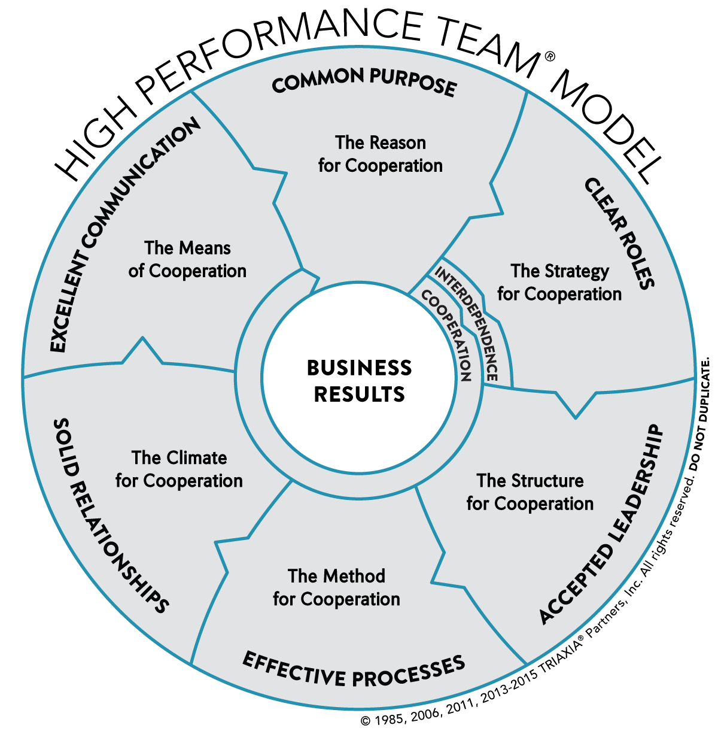
How to achieve a high-performance team

Slide 48
Project Managment Tool UI

Slide 49

Thanks for your attention!
Any Question?

